Slide 1
Save on CAUSE Expenses with RaiseRight
DRAG & DROP
SCHOOL LOGO HERE
Benefits of joining ORGANIZATION NAME’S RaiseRight Program
© 2026 RAISERIGHT

Slide 2
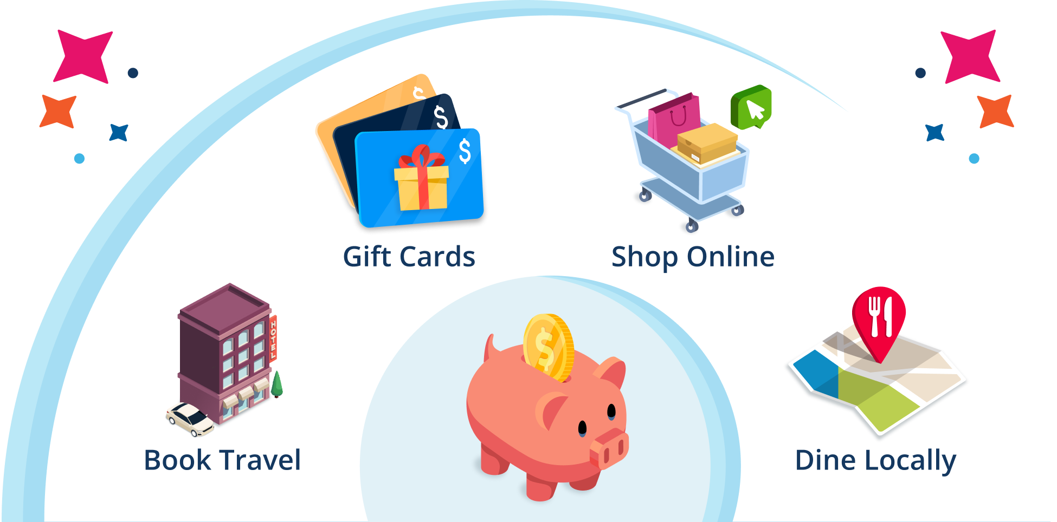
Fuel fundraising with everyday purchases
SHOP | DINE | TRAVEL
Our Everyday Earnings Engine lets you fundraise through shopping, dining, and travel, without selling anything or spending extra. It fits into what you're already doing, so you have more time to do what you love.

Slide 3
Benefits of Earning Money with RaiseRight
It’s Easy—RaiseRight fits right into your daily life with opportunities to earn anywhere you shop, dine, or travel.
It’s Effective—Brands automatically give up to 20% back to the school. Earnings are shared with you to offset costs.
It’s Limitless—Each family can earn $1,000 or more per year toward expenses.
It’s Flexible—With eGift cards, a mobile app, and a browser extension, earning can happen anywhere, anytime.

Slide 4



You buy gift cards
How to earn with gift cards
The brand gives back
Earnings go toward expenses
You get the full value—no extra money comes out of your pocket. Buy gift cards and eGift cards from hundreds of popular brands.
Earn money simply by using gift cards to pay for everyday purchases—instead of cash or credit cards.
A percentage of every gift card purchase automatically goes back to the school as earnings.
The school shares earnings with participating families to offset tuition and other school-related costs.

Slide 5

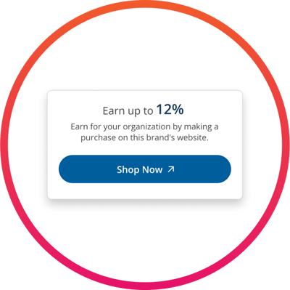
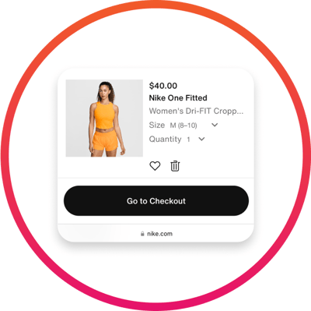
Select a Brand
How to earn on online shopping
Go shopping
Earn
Browse hundreds of brands on RaiseRight.com or the RaiseRight mobile app that offer online earnings.
Earn money simply by shopping online through RaiseRight.
Click through to the brand’s website, and shop like you normally do.
Automatically earn by completing a purchase on the brand’s website.

Slide 6



How to earn on local dining
Link a credit or debit card
Add cards directly in your RaiseRight account.
Search for restaurants
Earn 5% every time you use a linked credit or debit card to dine at one of 20,000+ participating restaurants nationwide.
Find nearby participating restaurants in the RaiseRight app.
Dine and earn 5%
Use your linked card to pay for your meals and earn 5% on your entire bill—tax and tip included!

Slide 7
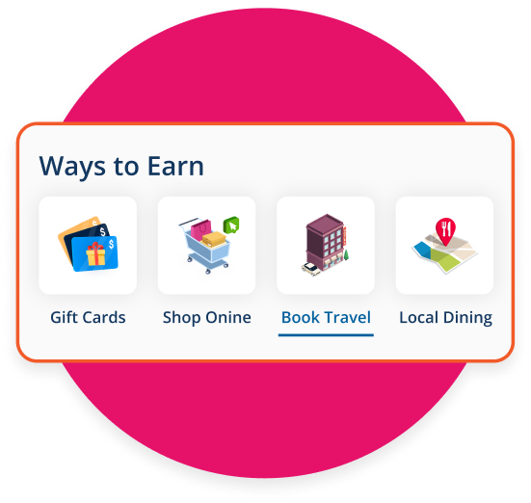
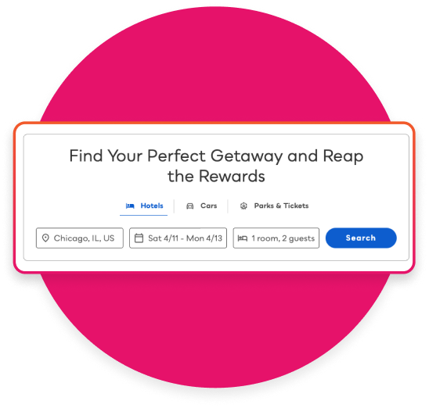
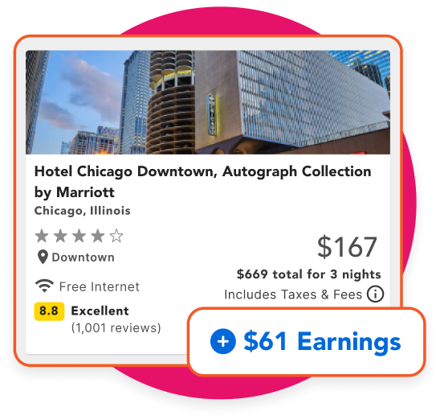
How to earn on booking travel
Visit the Book Travel tab
You’ll be redirected to our travel site to start your search.
Save and earn by booking hotels, car rentals, and attractions directly through RaiseRight.
Search hotels, cars, and attractions
Choose from 850,000+ hotels, 30,000+ car rental locations, and 100+ attractions.
Earn big on every booking
High-value travel expenses = high earnings for you and your organization.

Slide 8
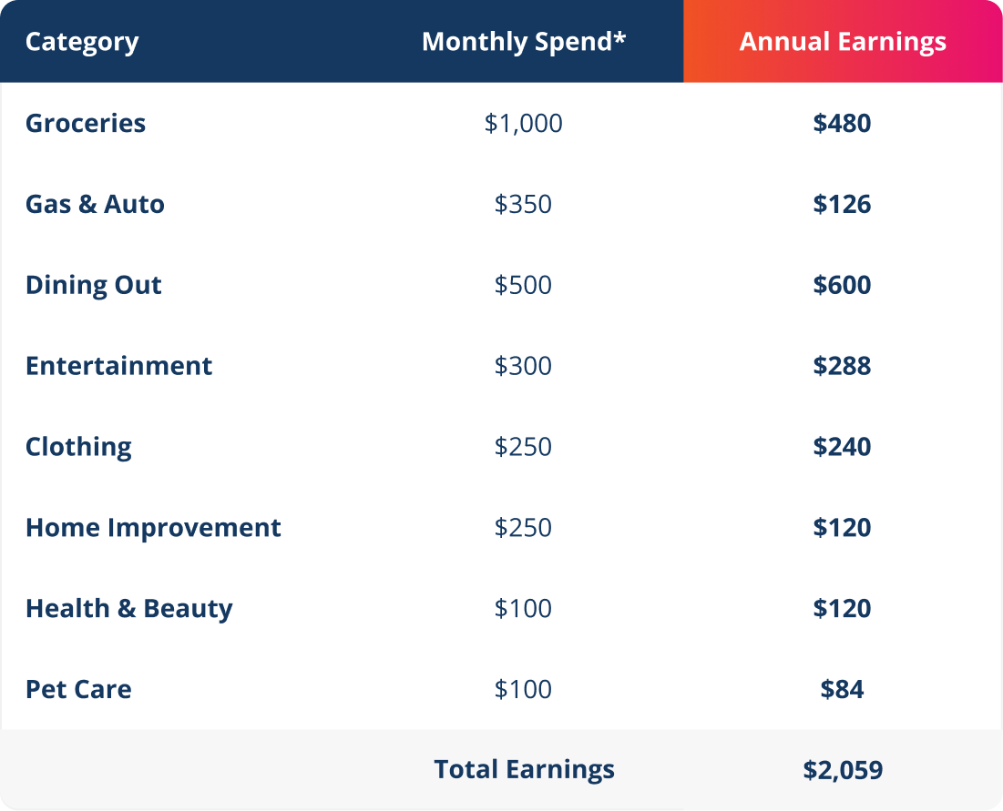
Everyday expenses = everyday earnings
*Based on average spend for a family of 4

Slide 9






What your earnings will fund
EDIT THIS SECTION TO INCLUDE WHAT YOUR RAISERIGHT PROGRAM FUNDS
Tuition and other school expenses
Extracurricular activities
Every purchase through RaiseRight automatically earns money! The school shares XX% of all earnings back with participating families.
Field Trips
Sports & playground equipment
Facility improvements
Fun fact! In 2025, the highest-earning school fundraiser on RaiseRight’s platform raised $249,000.

Slide 10
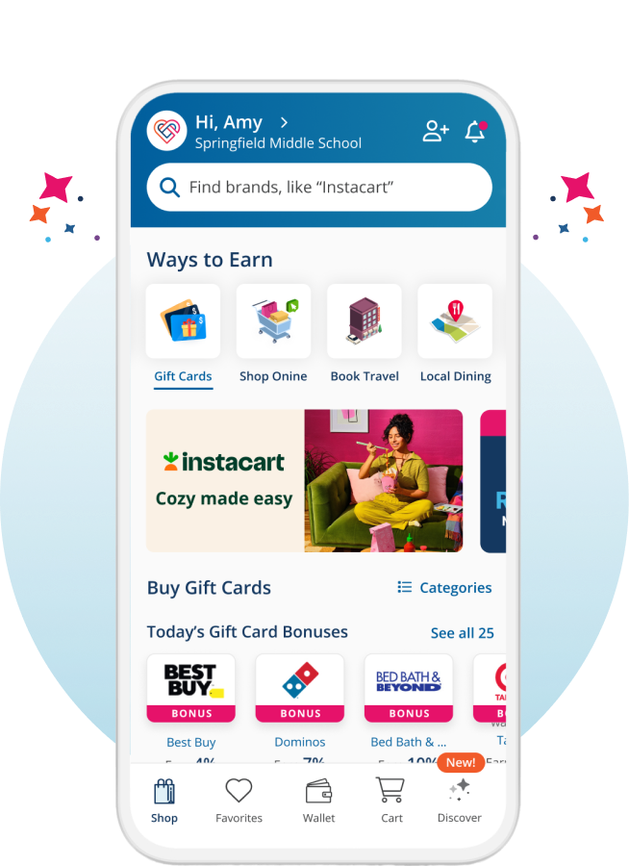
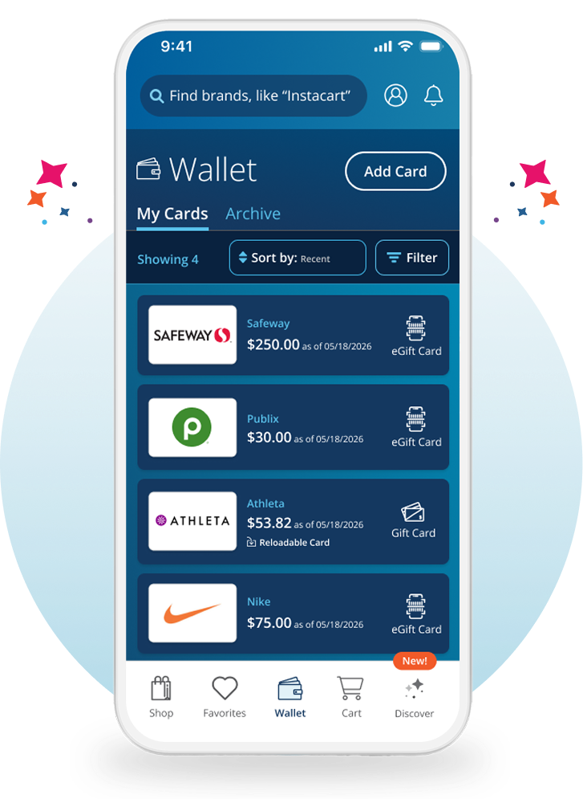


Earn on the go with the RaiseRight app
Purchase gift cards and shop online anywhere, anytime.
Instantly access your eGift cards and scan them at checkout while shopping, directly from your account Wallet.
Add funds to reloadable gift cards anytime. Every time you add funds, you earn!
Search for nearby participating restaurants to earn on local dining.
Download the RaiseRight app for free

Slide 11
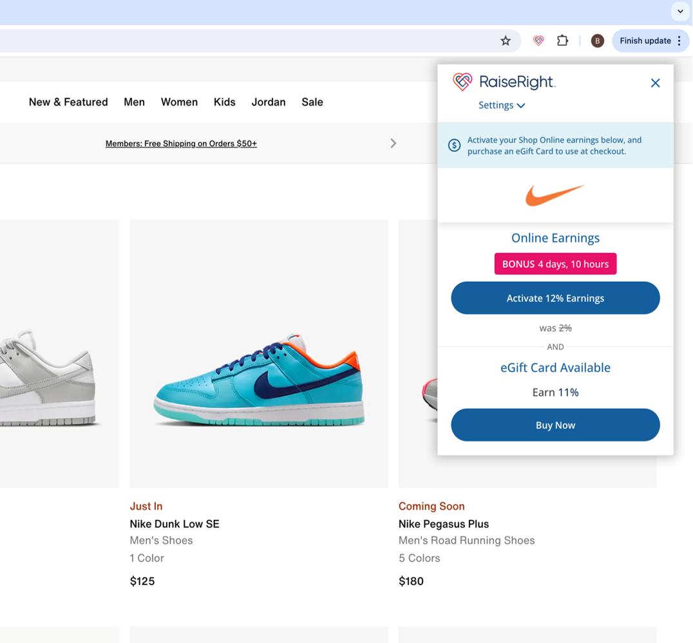
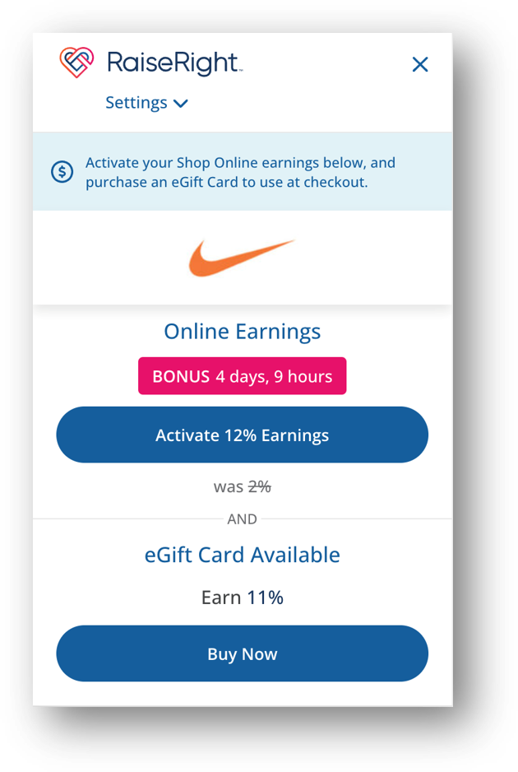
Never miss out on earnings while shopping online
Install the RaiseRight Earnings Extension to your desktop browser to get real-time earning reminders while shopping online.
Conveniently activate online earnings in a single click.
Quickly buy eGift cards to use as payment for your online purchases.
Install for FREE on Chrome or Edge browsers and Safari on your iPhone
11

Slide 12




eGift Cards
Gift cards for every kind of shopper
Physical Gift Cards
Reloadable Gift Cards
3 easy payment options are available:
Purchase gift cards securely and directly using your bank account, debit card,
or credit card.
Digital gift cards that are delivered instantly to your account “Wallet,” and accessible right from your phone—they can be scanned by the retailer for quick checkout.
Plastic or paper-based gift cards that are shipped to your organization or can be mailed direct to your home address using the Ship to Home feature.
Whether you’re an online, contactless shopper, or prefer to have your card in-hand, there is a gift card type available for you.
Allow you to electronically add more funds onto existing physical cards purchased from RaiseRight.

Slide 13



How to get started
1. Join the program
2. Create a secure account
3. Start earning
Scan the QR Code or sign up at RaiseRight.com/Enroll using the enrollment code provided by [COORDINATOR NAME].
Scan the QR code to join [SCHOOL NAME]’s RaiseRight program and start earning.
Complete the short signup form.
DOWNLOAD THE QR CODE FROM YOUR COORDINATOR DASHBOARD. DRAG & DROP IT HERE
Buy gift cards and eGift cards from hundreds of popular brands.
For more information, contact our program coordinator:
[COORDINATOR NAME]
[COORDINATOR EMAIL / PHONE]

